Slide 1
+ Habitação Impact on Short Term Rentals
Luciano Rodrigues – Setembro 2023
+ Habitação – Impactos no Alojamento Local
Versão 1.03

Slide 2
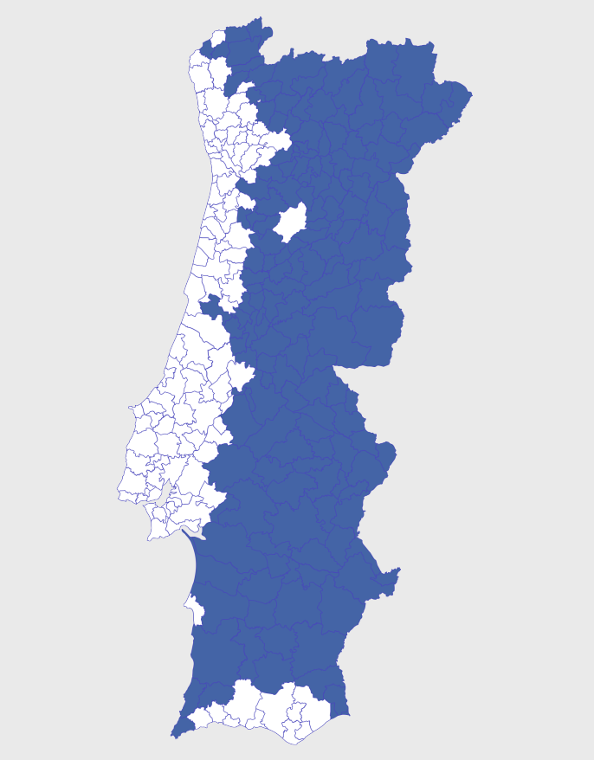
CEAL – Extraordinary Contribution of AL
- Yearly tax, applicable per property size in square meters, whose calculation depends of multiple variables, like City’s RevPAR for 2023
- Applicable in high density zones (White on map on right) for properties registered as AL as of 31st December 2023
- It’s forecasted that in most touristic zones CEAL will be around 40€ per square meter in 2023, due to be paid in June 2024. In less touristic zones it’s expected to be around 30€ per square meter, in 2024, due to be paid in June 2024.
- Owed by AL licence owner. Property owner is also responsible if licence owner do not fulfill the payment obligation
- Not applicable to properties which aren’t independent units or detached houses. No applicable also to registers as “Quartos”, as long as it’s Main Fiscal Residence and up to 120 nights per year
- It will be due in 2024 for properties registered as AL as of 31st December 2023. It’s possible to cancel the registry until then, avoiding to pay CEAL.
Luciano Rodrigues – September 2023
+ Habitação – Impact on Short Term Rentals

Slide 3
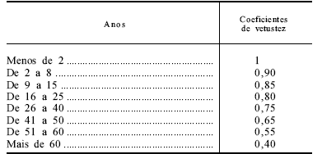
IMI – Property Tax increase
- All properties registered as AL (no location or register modality exceptions) will pay higher IMI – Property Tax
- Ageing Coefficient isn’t applicable on Valor Patrimonial Tributário calculation
- This means any AL will pay IMI – Property Tax exactly as if it was a brand new property
- On the right we can see all Ageing Coefficients applicable
- Exemple 1 – 35 years old property, yearly IMI was 300€ in 2023 (ageing coeficiente = 0,75) will pay 400€ after 2024
- Exemple 2 – 70 years old property, yearly IMI was 200€ in 2023 (ageing coeficiente = 0,40) will pay 500€ in 2024
- IMI – Property tax is owed by property owner
Luciano Rodrigues – September 2023
+ Habitação – Impact on Short Term Rentals

Slide 4
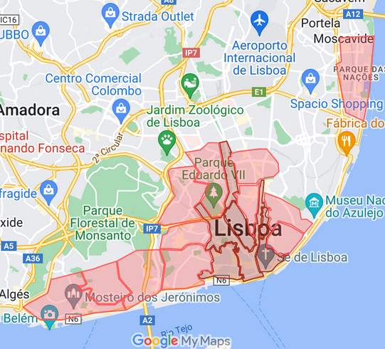
IRS – Income Tax increase
- AL registered as Apartamento / Moradia located in Área de Contenção – Contention Zones (Lisbon – see map ; Porto – Historical Center and Bonfim ; Ericeira) will have a Income Tax increase.
- IRS – Income Tax coefficient grows from 0,35 to 0,50
- This coefficient is “profit” forecast, which means forecasted profit for AL was 35%, but will now be 50%
- An AL with a gross income of 20.000€ was adding 7.000€ to IRS calculation until now. From now on, it will add 10.000€
- This means IRS rate will be higher, as well as tax subject ammount
- Increase will apply for 2023 income, whose income tax will be paid mid 2024.
Luciano Rodrigues – September 2023
+ Habitação – Impact on Short Term Rentals

Slide 5
New Registry/ Registry Change / Cancellation
- Forbidden any new registrys (as Apartamento or Estabelecimento de Hospedagem) in all zones painted white in the map on the right. Forbidden any new registries in any Area de Contenção (Lisbon and Porto downtown and Ericeira, as of today).
- Forbidden registry changes for changing managing company, by death or divorce, as an exemple
- AL registry owners will need to prove (not know yet how) their ALs are active up to 2 months after law is published. Otherwise, registry will be cancelled (and won’t be possible to ask new ones)
- AL registry is valid until 2030, when will be revaluated and possibly extended for 5 years periods
- This don’t apply to registered AL whose property is a colateral to bank loan (signed until February 2023). In this situation, registry is valid up to maturity date of loan.
- Cancellation of AL registry for properties detained by companies, if capital structure has changes in it’s shareholders.
Luciano Rodrigues – September 2023
+ Habitação – Impact on Short Term Rentals

Slide 6
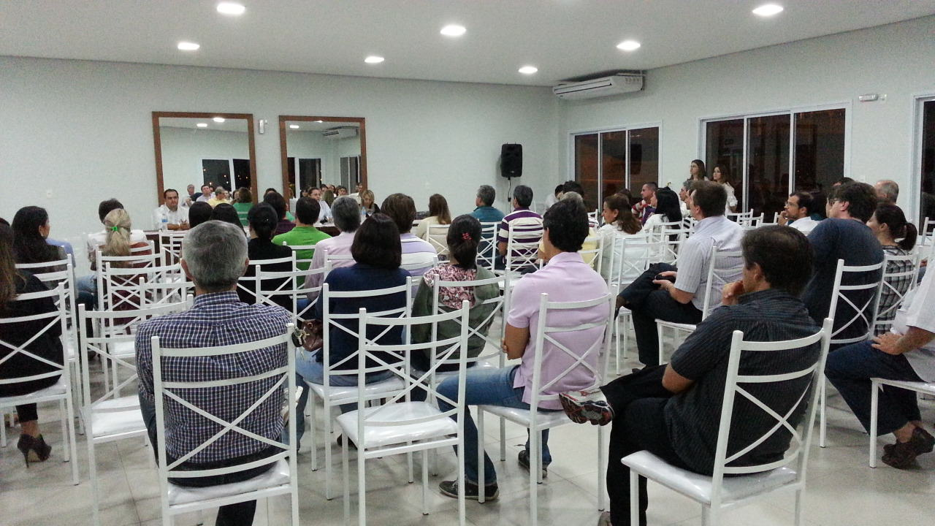
Condominiuns
- It’s mandatory unanimous approval by Home Owners Association prior to new ALs registry
- Home Owners Association can request Town Hall to cancel AL registration, without any attendable reason. 2/3 of votes (total Condominium área) are enough to aprove it. Town Hall will inform of a 60 day deadline to close AL.
- This adds to the already existing possibility of Condominium increasing up to 30% the contribution for a property located in the condominium

Slide 7
+ Habitação Impact on Long Term Rentals
Luciano Rodrigues – Setembro 2023
+ Habitação – Impact on Long Term Rentals

Slide 8
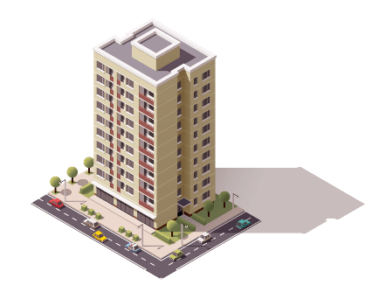
IRS – Income Tax reduction
- Reduction of taxation from 28% to 25%
- IRS reductions as follows:
- 5 to 10 years – 15%
- 10 to 20 years – 10%
- More than 20 years – 5%
- This IRS reductions won’t apply to properties rented after 1st January 2024 and whose rent surpasses, in more than 50%, the price limits per property size and location
- IRS or IRC (profit tax for companys) exemption, during 5 years, for properties registered as AL as of 31st December 2022, whose AL registry is cancelled up to 31st December 2023. Property must be subject to long term rental for main residency purposes of the Tenant.
Luciano Rodrigues – Setembro 2023
+ Habitação – Impact on Long Term Rentals

Slide 9
Capital Gains exemption / Rent Limits
- Capial Gains obtained selling propertys to Government or Town Hall are IRS – Income Tax exempt (unless sale is a Direito de Preferência (every Town Hall has the right to match the selling price agreed, having priority purchasing it) or if seller is located in a Tax Heaven)
- Capital Gains exemption for properties sold between 1st January 2022 and 31st December 2024, if sale ammount is used to repay Primary Residency morgage of seller or it’s descendants
- 2% rent increase to new contracts, for properties which were already in Long Term Rental market in last 5 years.
Luciano Rodrigues – Setembro 2023
+ Habitação – Impact on Long Term Rentals

